Slide 1
Lecture 11 Shortest Paths
Department of Computer Science
Hofstra University

Slide 2
Lecture Goals
In this lecture we study shortest-paths problems. We begin by analyzing some basic properties of shortest paths and a generic algorithm for the problem.
We introduce and analyze Dijkstra's algorithm for shortest-paths problems with nonnegative weights.
Next, we consider Topological Sort for Edge-weighted DAG, which works even if the weights are negative.
Next, we consider the Bellman–Ford algorithm for edge-weighted digraphs with no negative cycles.
We conclude with the Floyd Warshall Algorithm for all-pairs shortest path

Slide 3
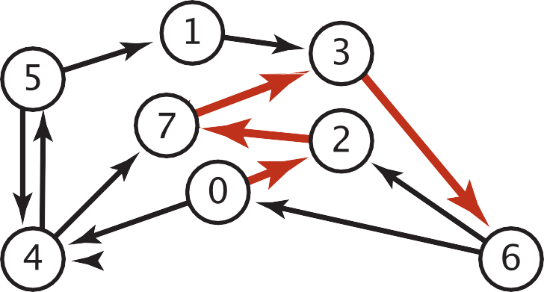
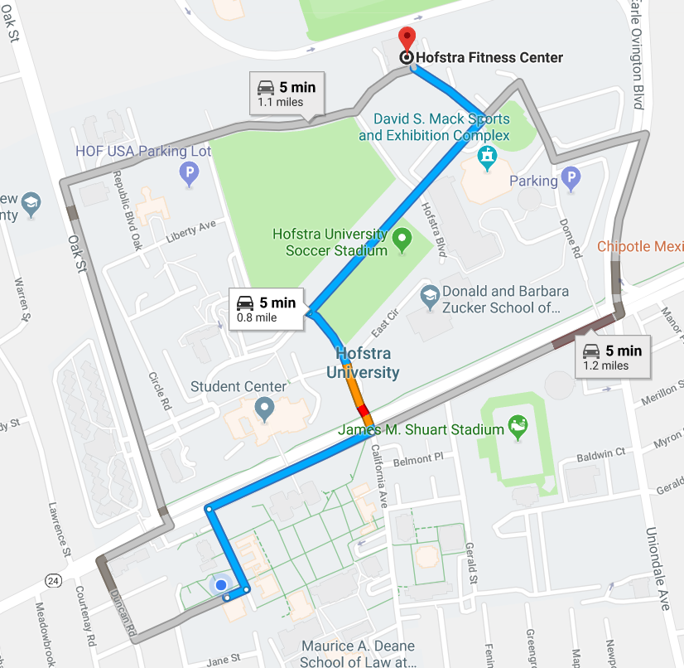

Shortest Paths in an Edge-weighted Digraph
Given an edge-weighted digraph, find the shortest path from s to t.
edge-weighted digraph
shortest path from 0 to 6
0->2 0.26
4->5 | 0.35
5->4 | 0.35
4->7 | 0.37
5->7 | 0.28
7->5 | 0.28
5->1 | 0.32
0->4 | 0.38
0->2 | 0.26
7->3 | 0.39
1->3 | 0.29
2->7 | 0.34
6->2 | 0.40
3->6 | 0.52
6->0 | 0.58
6->4 | 0.93
2->7 | 0.34
7->3 | 0.39
3->6 | 0.52
Variants
Can we use BFS?
Which vertices?
Single source: from one vertex s to every other vertex.
Source-sink: from one vertex s to another t.
All pairs: between all pairs of vertices.
Nonnegative weights?
Cycles?
Negative cycles.
Simplifying assumption: Each vertex is reachable from s.

Slide 4

Edge Relaxation
Relax edge e = v→w. (basic of building SPT)
distTo[v] is length of shortest known path from s to v.
distTo[w] is length of shortest known path from s to w.
prevNode[w] is the previous node on shortest known path from s to w.
If e = v→w gives shorter path to w through v, update distTo[w] and prevNode[w].
distTo[w] = min(distTo[w], distTo[v] + e.weight()); prevNode[w]=v
private void relax(DirectedEdge e)
{
int v = e.from(), w = e.to();
if (distTo[w] > distTo[v] + e.weight())
{
distTo[w] = distTo[v] + e.weight();
prevNode[w] = v;
}
}
After relaxing edge v→w, the shortest path from s to w is updated to go through node v, with cost of 4.4
prevNode[w] = v
3.1
v
1.3
s
w
7.2
OLD distTo[w] = 7.2 > distTo[v] + e.weight()
= 3.1+1.3 = 4.4
NEW distTo[w] ← distTo[v] + e.weight() = 4.4, prevNode[w] = v
u
Previous shortest path from s to w goes through node u, with cost of 7.2

Slide 5
Generic Shortest-paths Algorithm
Generic algorithm (to compute SPT from s)
For each vertex v: distTo[v] = ∞.
For each vertex v: prevNode[v] = null.
distTo[s] = 0.
Repeat until done:
- Relax any edge.
Proposition. Generic algorithm computes SPT (if it exists) from s.
Pf.
Throughout algorithm, distTo[v] is the length of a simple path from s to v (and prevNode[v] is its previous node on the path).
Each successful relaxation decreases distTo[v] for some v.
The entry distTo[v] can decrease at most a finite number of times.
Efficient implementations. How to choose which edge to relax?
Ex 1. Dijkstra’s algorithm. (no negative weights).
Ex 2. Bellman–Ford algorithm. (negative weights, no negative cycles).
Notes:
Ex 2. Topological sort algorithm. (no directed cycles).

Slide 6
Dijkstra's Algorithm
Initialization:
Set the distance to the source node as 0 and to all other nodes as infinity.
Mark all nodes as unvisited and store them in a priority queue.
Main Loop:
Visit the unvisited node v with the shortest known distance from the queue.
For each unvisited neighbor node w of node v, calculate its tentative distance through the current node. If this distance is smaller than the previously recorded distance, update it with edge relaxation for edge v-w.
Mark the current node as visited once all its neighbors are processed.
Termination:
The algorithm continues until all reachable nodes are visited, or until the shortest path to a specific destination is found.
(Note: Dijkstra’s algorithm works for both undirected and directed graphs. The only difference is the function for getting the neighbors of node v, which follows the edge arrow direction for directed graphs.)

Slide 7
Dijkstra’s Algorithm: Correctness Proof
Proposition. Dijkstra's algorithm computes a SPT in any edge-weighted digraph with nonnegative weights.
Pf.
Each edge e = v→w is relaxed exactly once (when v is relaxed),
leaving distTo[w] ≤ distTo[v] + e.weight().
Inequality holds until algorithm terminates because:
distTo[w] cannot increase
distTo[v] will not change
Thus, upon termination, shortest-paths optimality conditions hold.
distTo[ ] values are monotone decreasing
we choose lowest distTo[ ] value at each step (and edge weights are nonnegative)

Slide 8
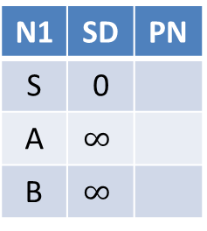
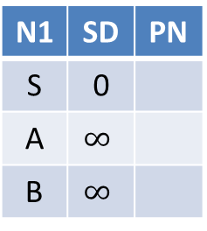
Toy Example: Run Dijkstra’s algorithm starting from source node S
A
2
S
1
4
B
N1 | SD | PN
S | 0
A | $$∞$$
B | $$∞$$
N1 | SD | PN
S | 0
A | 2 | S
B | 4 | S
N1 | SD | PN
S | 0
A | 2 | S
B | 3 | A
N1 | SD | PN
S | 0
A | 2 | S
B | 3 | A
Visit S
Visit A
Visit B
A
2
S
3
4
B
N1 | SD | PN
S | 0
A | $$∞$$
B | $$∞$$
N1 | SD | PN
S | 0
A | 2 | S
B | 4 | S
N1 | SD | PN
S | 0
A | 2 | S
B | 4 | S
N1 | SD | PN
S | 0
A | 2 | S
B | 4 | S
Visit S
Visit A
Visit B

Slide 9
Video Tutorials
Dijkstras Shortest Path Algorithm Explained | With Example | Graph Theory
https://www.youtube.com/watch?v=bZkzH5x0SKU
The following lecture slides are based on this video
Dijkstra's algorithm in 3 minutes
https://www.youtube.com/watch?v=_lHSawdgXpI
Bellman-Ford in 4 minutes — Theory
https://www.youtube.com/watch?v=9PHkk0UavIM
Bellman-Ford in 5 minutes — Step by step example
https://www.youtube.com/watch?v=obWXjtg0L64

Slide 10
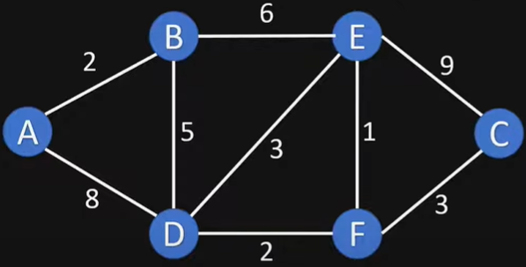
Example Graph

Slide 11
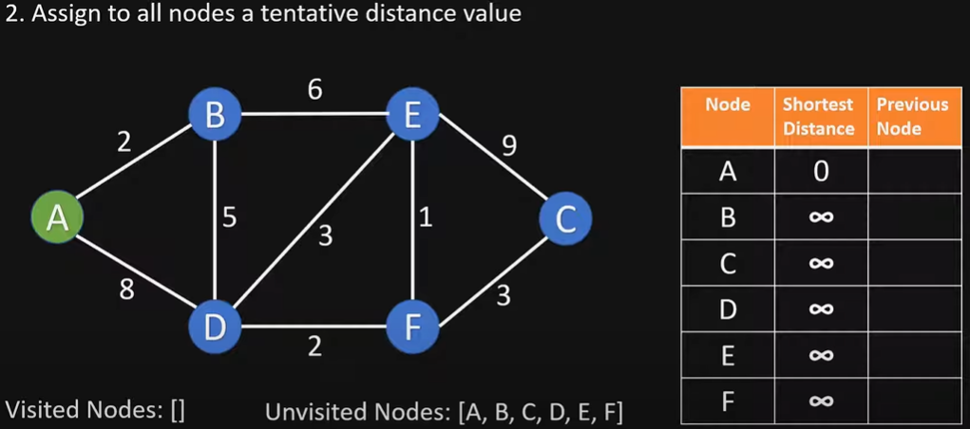
Initialize

Slide 12
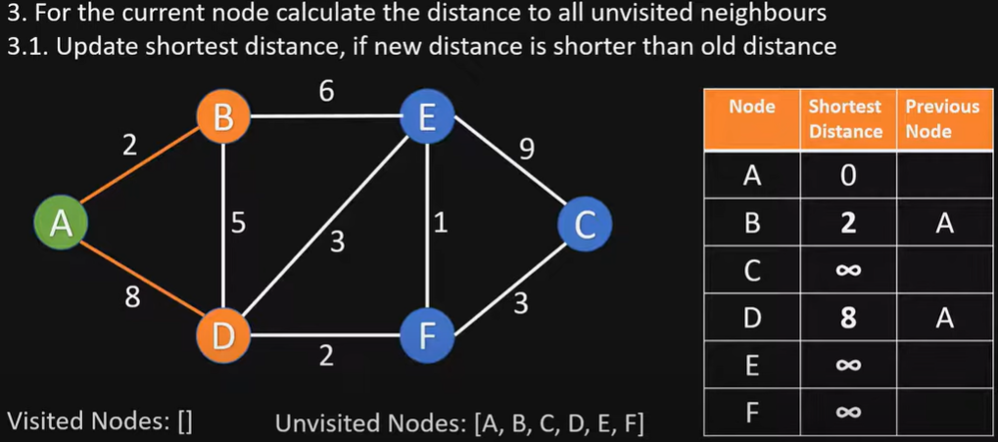
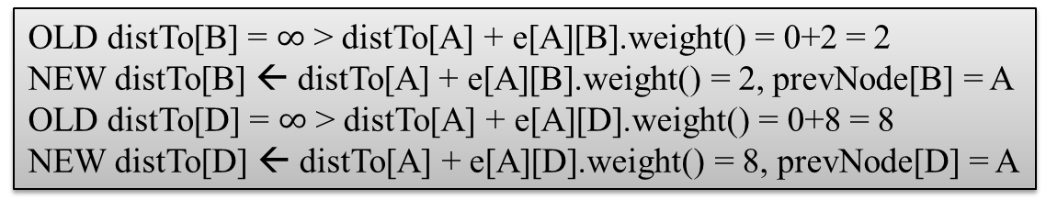
Visit Node A
OLD distTo[B] = $∞$ > distTo[A] + e[A][B].weight() = 0+2 = 2
NEW distTo[B] ← distTo[A] + e[A][B].weight() = 2, prevNode[B] = A
OLD distTo[D] = $∞$ > distTo[A] + e[A][D].weight() = 0+8 = 8
NEW distTo[D] ← distTo[A] + e[A][D].weight() = 8, prevNode[D] = A

Slide 13
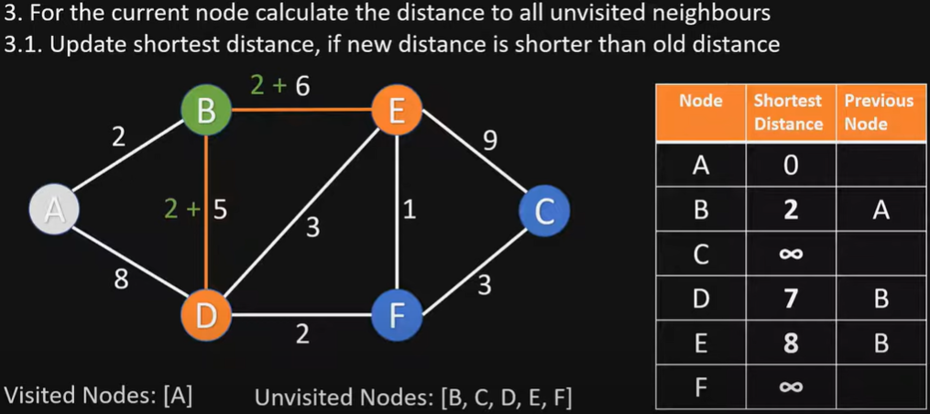
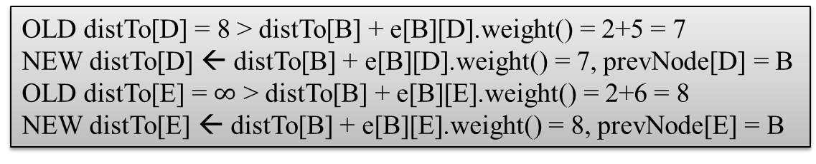
Visit Node B
OLD distTo[D] = 8 > distTo[B] + e[B][D].weight() = 2+5 = 7
NEW distTo[D] ← distTo[B] + e[B][D].weight() = 7, prevNode[D] = B
OLD distTo[E] = $∞$ > distTo[B] + e[B][E].weight() = 2+6 = 8
NEW distTo[E] ← distTo[B] + e[B][E].weight() = 8, prevNode[E] = B

Slide 14
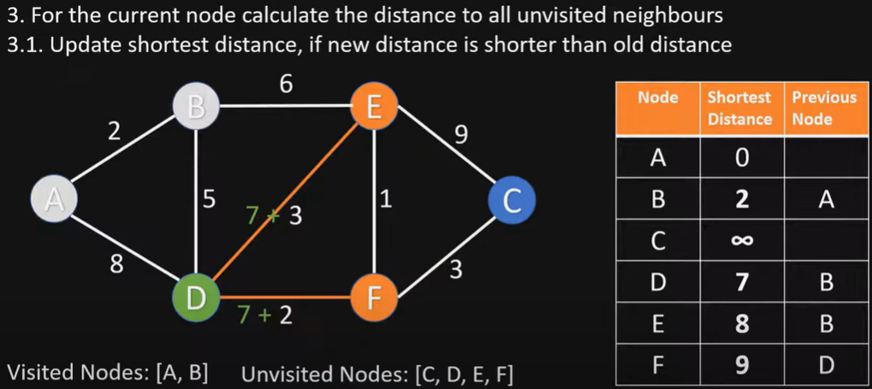
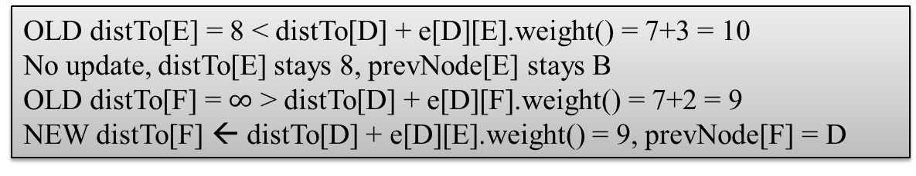
Visit Node D
OLD distTo[E] = 8 < distTo[D] + e[D][E].weight() = 7+3 = 10
No update, distTo[E] stays 8, prevNode[E] stays B
OLD distTo[F] = $∞$ > distTo[D] + e[D][F].weight() = 7+2 = 9
NEW distTo[F] ← distTo[D] + e[D][E].weight() = 9, prevNode[F] = D

Slide 15
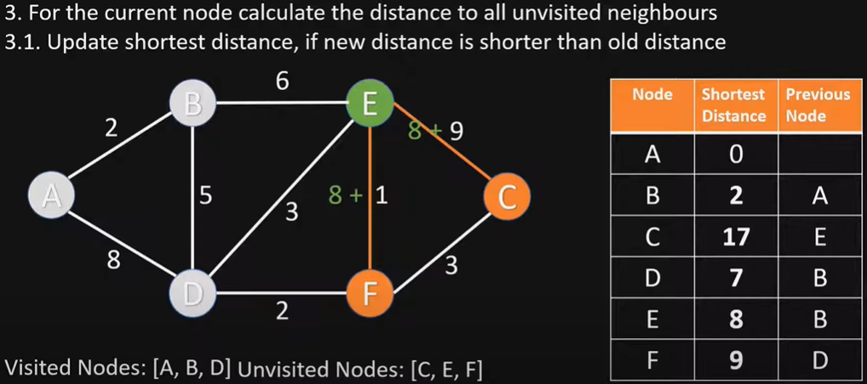
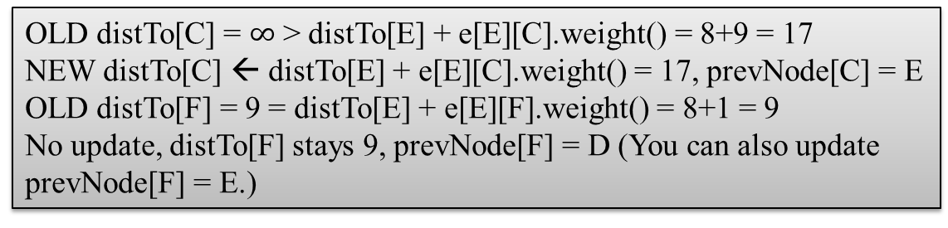
Visit Node E
OLD distTo[C] = $∞$ > distTo[E] + e[E][C].weight() = 8+9 = 17
NEW distTo[C] ← distTo[E] + e[E][C].weight() = 17, prevNode[C] = E
OLD distTo[F] = 9 = distTo[E] + e[E][F].weight() = 8+1 = 9
No update, distTo[F] stays 9, prevNode[F] = D (You can also update prevNode[F] = E.)

Slide 16
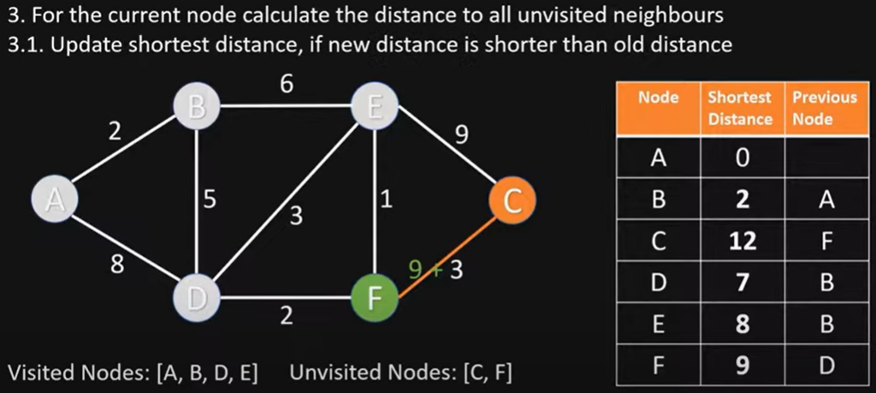
Visit Node F
OLD distTo[C] = 17 > distTo[F] + e[F][C].weight() = 9+3 = 12
NEW distTo[C] ← distTo[F] + e[F][C].weight() = 12, prevNode[C] = F

Slide 17
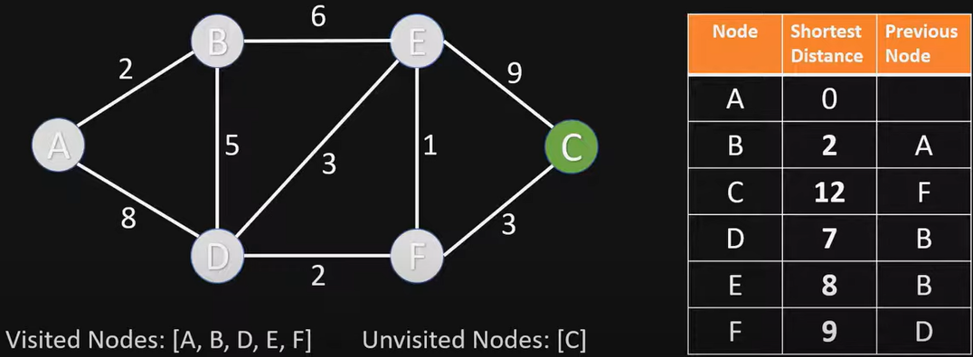
Visit Node C
Nothing changes, since C has no unvisited neighbor nodes

Slide 18
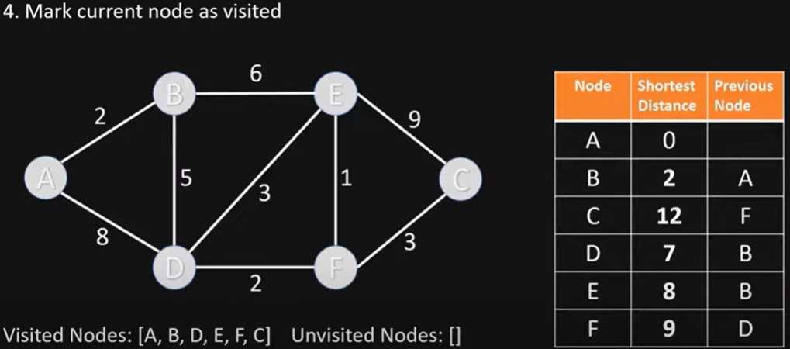
End of Algorithm
Table contains the shortest distance to each node N from the source node A, and its previous node in the shortest path

Slide 19
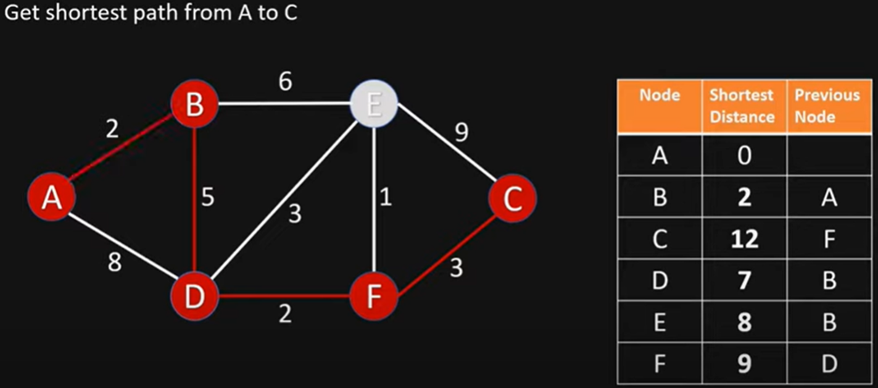
Getting the Shortest Path from A to C
C’s previous node is F; F’s previous node is D; D’s previous node is B; B’s previous node is A
Shortest Path from A to C is ABDFC

Slide 20
Dijkstra’s Algorithm Example 2
3
B
D
3
1
A
1
2
1
C
E
4
Notes:
David Kauchak
cs161
Summer 2009
Graphs: MSTs and Shortest Paths https://cs.pomona.edu/~dkauchak/classes/algorithms/

Slide 21
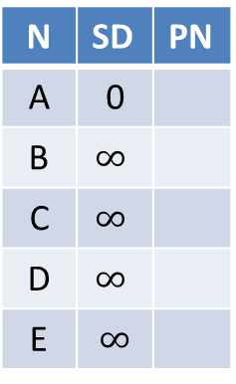
Initialize
∞
∞
3
N | SD | PN
A | 0
B | $$∞$$
C | $$∞$$
D | $$∞$$
E | $$∞$$
B
D
3
0
1
A
1
2
∞
1
C
E
∞
4

Slide 22
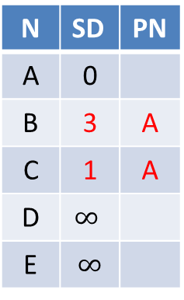
Visit Node A
3
∞
3
N | SD | PN
A | 0
B | 3 | A
C | 1 | A
D | $$∞$$
E | $$∞$$
B
D
3
0
1
A
1
2
1
1
C
E
∞
4

Slide 23
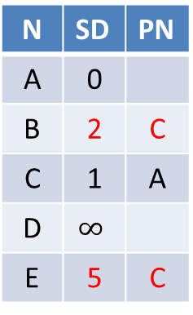
Visit Node C
2
∞
3
N | SD | PN
A | 0
B | 2 | C
C | 1 | A
D | $$∞$$
E | 5 | C
B
D
3
0
1
A
1
2
1
1
C
E
5
4

Slide 24
Visit Node B
2
5
3
N | SD | PN
A | 0
B | 2 | C
C | 1 | A
D | 5 | B
E | 3 | B
B
D
3
0
1
A
1
2
1
1
C
E
3
4

Slide 25
Visit Node E
2
5
3
B
D
N | SD | PN
A | 0
B | 2 | C
C | 1 | A
D | 5 | B
E | 3 | B
3
0
1
A
1
2
1
1
C
E
3
4
Nothing changes

Slide 26
Visit Node D
2
5
3
N | SD | PN
A | 0
B | 2 | C
C | 1 | A
D | 5 | B
E | 3 | B
B
D
3
0
1
A
1
2
1
1
C
E
3
4
Nothing changes

Slide 27
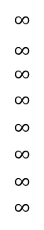
Dijkstra’s Algorithm Example 3
choose vertex 5
relax all edges adjacent from 5
choose vertex 2
relax all edges adjacent from 2
choose vertex 3
relax all edges adjacent from 3
choose vertex 6
relax all edges adjacent from 6
Consider vertices in increasing order of distance from s
(non-tree vertex with the lowest distTo[ ] value).
Add vertex to tree and relax all edges pointing from that vertex.
1
v distTo[]
15
3
$$∞$$
$∞$ $∞$
$$∞$$
$$∞$$
$$∞$$
$$∞$$
$$∞$$
0
5
17
20
9
14
29
8
15
17
13
26
14
25
0
1
2
3
4
5
6
7
5
4
12
0
3
8
7
2
7
9
9
5
6
1
5
11
v edgeTo[]
4
4
13
6
0
1
2
3
4
5
6
7
-
-
-
-
-
-
-
-
0
1
1
0
7
4
0
7
2
4
5
5
2
20
choose source vertex 0
relax all edges adjacent from 0
choose vertex 1
relax all edges adjacent from 1
choose vertex 7
relax all edges adjacent from 7
choose vertex 4
relax all edges adjacent from 4

Slide 28
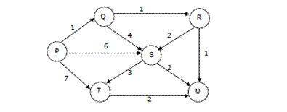
Quiz: Dijstra’s Algorithm
Suppose we run Dijkstra’s single source shortest-path algorithm on the following edge weighted directed graph with vertex P as the source. In what order do the nodes get included into the set of vertices for which the shortest path distances are finalized?
ANS: P, Q, R, U, S, T

Slide 29
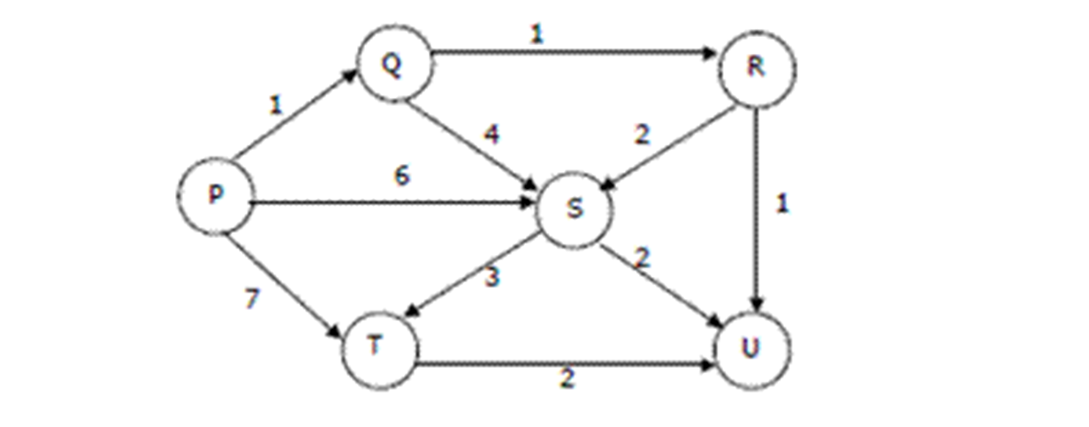
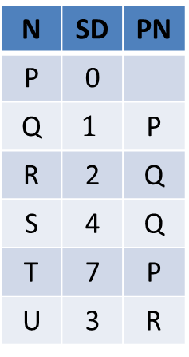
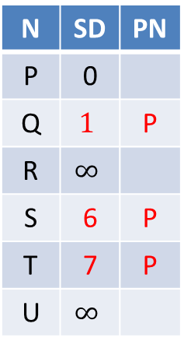

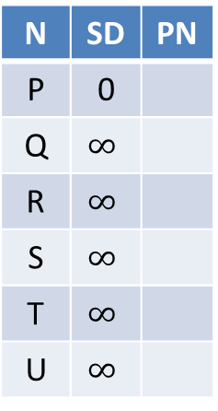
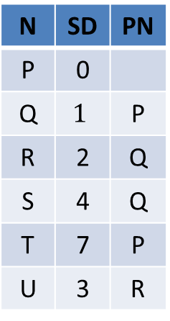
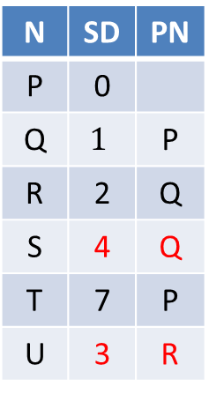
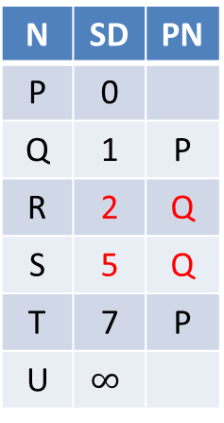
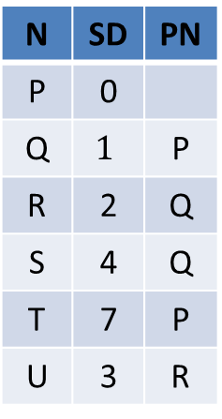
SD: Shortest Distance
PN: Previous Node
N | SD | PN
P | 0
Q | $$∞$$
R | $$∞$$
S | $$∞$$
T | $$∞$$
U | $$∞$$
N | SD | PN
P | 0
Q | $$1$$ | P
R | $$∞$$
S | 6 | P
T | 7 | P
U | $$∞$$
N | SD | PN
P | 0
Q | 1 | P
R | 2 | Q
S | 5 | Q
T | 7 | P
U | $$∞$$
N | SD | PN
P | 0
Q | $$1$$ | P
R | 2 | Q
S | 4 | Q
T | 7 | P
U | 3 | R
Visit P
Visit Q
Visit R
Visit U (nothing changes)
N | SD | PN
P | 0
Q | $$1$$ | P
R | 2 | Q
S | 4 | Q
T | 7 | P
U | 3 | R
N | SD | PN
P | 0
Q | $$1$$ | P
R | 2 | Q
S | 4 | Q
T | 7 | P
U | 3 | R
N | SD | PN
P | 0
Q | $$1$$ | P
R | 2 | Q
S | 4 | Q
T | 7 | P
U | 3 | R
N | SD | PN
P | 0
Q | $$1$$ | P
R | 2 | Q
S | 4 | Q
T | 7 | P
U | 3 | R
Visit S
Visit T
Finished
(nothing
changes)
(nothing
changes)

Slide 30
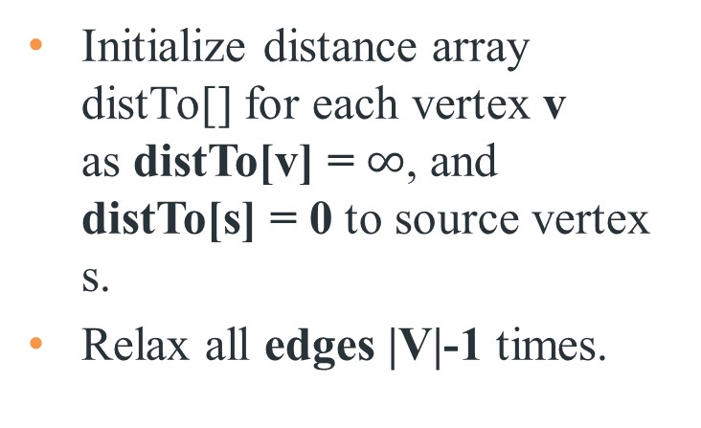
Bellman-Ford Algorithm
Initialize distance array distTo[] for each vertex v as distTo[v] = $∞$, and distTo[s] = 0 to source vertex s.
Relax all edges |V|-1 times.
Recall:
Generic algorithm (to compute SPT from s)
For each vertex v: distTo[v] = ∞.
For each vertex v: edgeTo[v] = null.
distTo[s] = 0.
Repeat until done:
- Relax any edge.
private void relax(DirectedEdge e)
{
int v = e.from(), w = e.to();
if (distTo[w] > distTo[v] + e.weight())
{
distTo[w] = distTo[v] + e.weight();
edgeTo[w] = e;
}
}
Bellman–Ford algorithm
For each vertex v: distTo[v] = ∞.
For each vertex v: edgeTo[v] = null.
distTo[s] = 0.
Repeat |V | -1 times:
- Relax each edge.
Notes:
Now, Relax all the edges one more time i.e. the Nth time and based on the below two cases we can detect the negative cycle:
Case 1 (Negative cycle exists): For any edge(u, v, weight), if dist[u] + weight < dist[v]
Case 2 (No Negative cycle) : case 1 fails for all the edges.
Initialize distance array dist[] for each vertex ‘v‘ as dist[v] = INFINITY.
Assume any vertex (let’s say ‘0’) as source and assign dist = 0.
Relax all the edges(u,v,weight) N-1 times as per the below condition:
dist[v] = minimum(dist[v], distance[u] + weight)
Now, Relax all the edges one more time i.e. the Nth time and based on the below two cases we can detect the negative cycle:
Case 1 (Negative cycle exists): For any edge(u, v, weight), if dist[u] + weight < dist[v]
Case 2 (No Negative cycle) : case 1 fails for all the edges.

Slide 31
Bellman-Ford Algorithm Proof of Correctness
Relaxing edges |V|-1 times in the Bellman-Ford Algorithm guarantees that the algorithm has explored all possible paths of length up to |V|-1, which is the maximum possible length of a shortest path in a graph with |V| vertices. This allows the algorithm to correctly calculate the shortest paths from the source vertex to all other vertices, given that there are no negative-weight cycles.

Slide 32
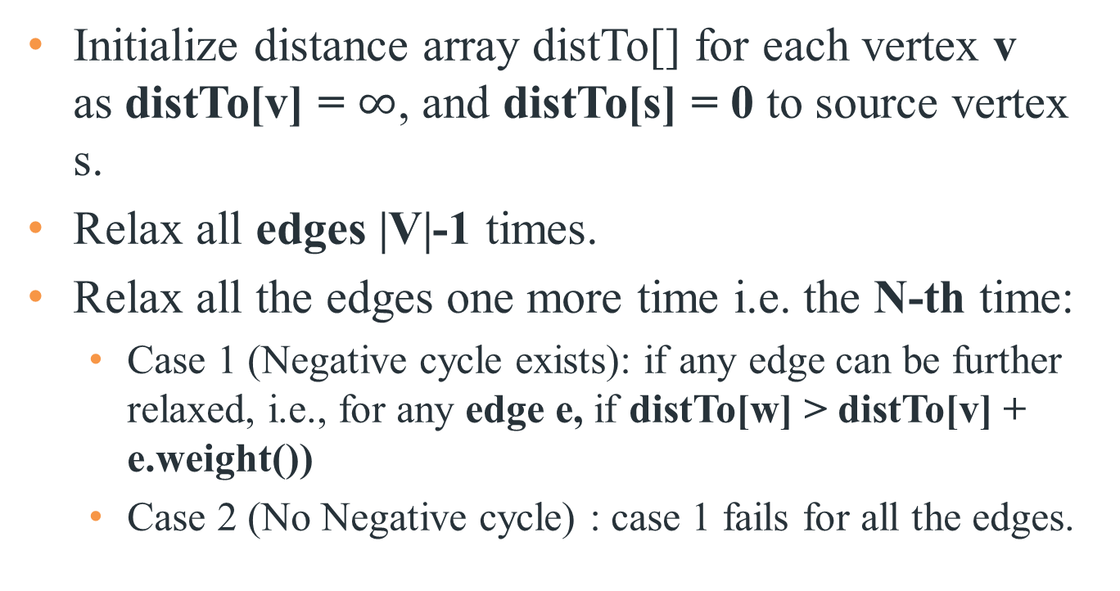
Bellman-Ford Algorithm with Negative Cycle Detection
Initialize distance array distTo[] for each vertex v as distTo[v] = $∞$, and distTo[s] = 0 to source vertex s.
Relax all edges |V|-1 times.
Relax all the edges one more time i.e. the N-th time:
Case 1 (Negative cycle exists): if any edge can be further relaxed, i.e., for any edge e, if distTo[w] > distTo[v] + e.weight())
Case 2 (No Negative cycle) : case 1 fails for all the edges.
Notes:
Initialize distance array dist[] for each vertex ‘v‘ as dist[v] = INFINITY.
Assume any vertex (let’s say ‘0’) as source and assign dist = 0.
Relax all the edges(u,v,weight) N-1 times as per the below condition:
dist[v] = minimum(dist[v], distance[u] + weight)
Now, Relax all the edges one more time i.e. the Nth time and based on the below two cases we can detect the negative cycle:
Case 1 (Negative cycle exists): For any edge(u, v, weight), if dist[u] + weight < dist[v]
Case 2 (No Negative cycle) : case 1 fails for all the edges.

Slide 33
Time Complexity of Bellman-Ford Algorithm
Time complexity for connected graph:
Best Case: O(|E|), when distance array after 1st and 2nd relaxation are same , we can simply stop further processing after one iteration
Average Case: O(|V|*|E|)
Worst Case: O(|V|*|E|)
If the graph is complete, the value of E becomes O(|V|²). So overall time complexity becomes O(|V|³)
Notes:
What is the time complexity of Bellman-Ford single-source shortest path algorithm on a complete graph of n vertices?
ANS: O(V3)
Time complexity of Bellman-Ford Algorithm Example 1 is O(VE) where V is number of vertices and E is number edges . If the graph is complete, the value of E becomes O(V2). So overall time complexity becomes O(V3)

Slide 34
Bellman-Ford Algorithm Example 1
0
∞
10
S
A
Iteration: 0
8
1
∞
∞
G
-4
B
2
1
1
-2
C
∞
F
∞
-1
3
E
D
-1
∞
∞

Slide 35
Bellman-Ford Algorithm Example 1
0
10
10
S
A
Iteration: 1
8
1
∞
8
G
-4
B
2
1
1
-2
C
∞
F
∞
-1
3
E
D
-1
∞
∞

Slide 36
Bellman-Ford Algorithm Example 1
0
10
10
S
A
Iteration: 2
8
1
∞
8
G
-4
B
2
1
1
-2
C
∞
F
9
-1
3
E
D
-1
12
∞

Slide 37
Bellman-Ford Algorithm Example 1
0
5
10
S
A
Iteration: 3
8
1
10
8
G
-4
B
A has the correct distance and path
2
1
1
-2
C
∞
F
9
-1
3
E
D
-1
8
∞

Slide 38
Bellman-Ford Algorithm Example 1
0
5
10
S
A
Iteration: 4
8
1
6
8
G
-4
B
2
1
1
-2
C
11
F
9
-1
3
E
D
-1
7
∞

Slide 39
Bellman-Ford Algorithm Example 1
0
5
10
S
A
Iteration: 5
8
1
5
8
G
-4
B
B has the correct distance and path
2
1
1
-2
C
7
F
9
-1
3
E
D
-1
7
14

Slide 40
Bellman-Ford Algorithm Example 1
0
5
10
S
A
Iteration: 6
8
1
5
8
G
-4
B
2
1
1
-2
C
6
F
9
-1
3
E
D
-1
7
10

Slide 41
Bellman-Ford Algorithm Example 1
0
5
10
S
A
Iteration: 7
8
1
5
8
G
-4
B
D (and all other nodes) have the correct distance and path
2
1
1
-2
C
6
F
9
-1
3
E
D
-1
7
9

Slide 42
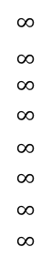
Bellman-Ford Algorithm Example 2
Repeat V − 1 times: relax all E edges.
v distTo[]
0
1
2
3
4
5
6
7
$$∞$$
$∞$ $∞$
$$∞$$
$$∞$$
$$∞$$
$$∞$$
$$∞$$
0
5
17
20
9
13
28
8
14
17
26
25
1
15
3
5
4
12
0
3
8
7
2
7
9
v edgeTo[]
9
5
6
1
0
1
2
3
4
5
6
7
-
-
-
-
-
-
-
-
0
1
1
0
4
2
0
5
2
5
2
5
11
4
4
13
20
6
pass 1
pass 2
pass 3
(no further changes)
pass 4-7 (no further changes)
0→1 0→4 0→7 1→2 1→3 1→7 2→3 2→6 3→6 4→5 4→6 4→7 5→2 5→6 7→2 7→5

Slide 43
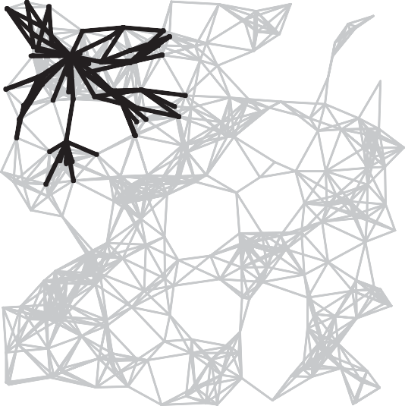
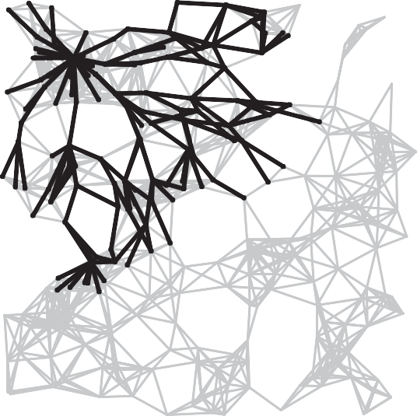
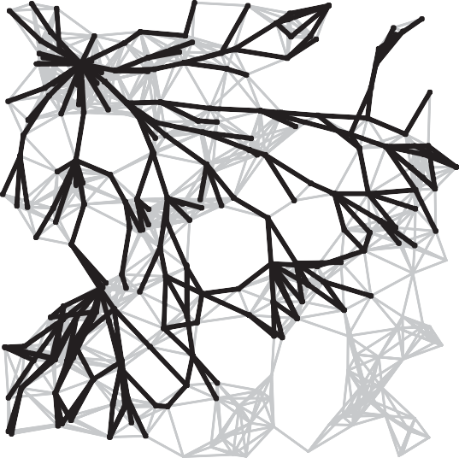
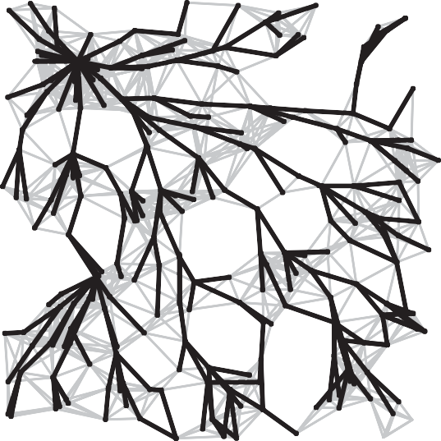
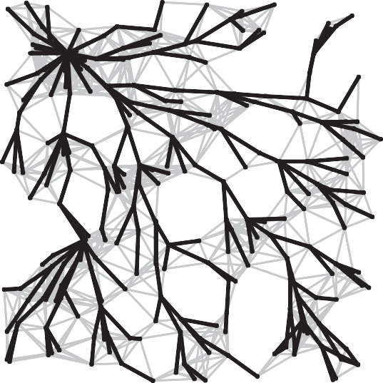
Bellman-Ford Algorithm Visualization
passes 4
7
10
13
SPT

Slide 44
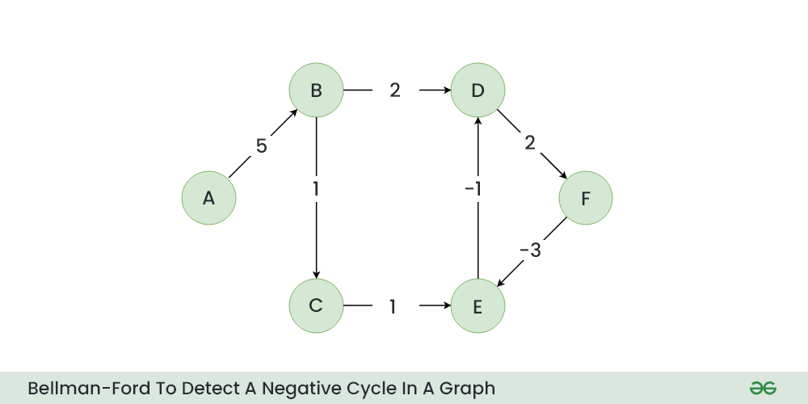
Bellman-Ford Algorithm Example 3 w. Negative Cycle

Slide 45
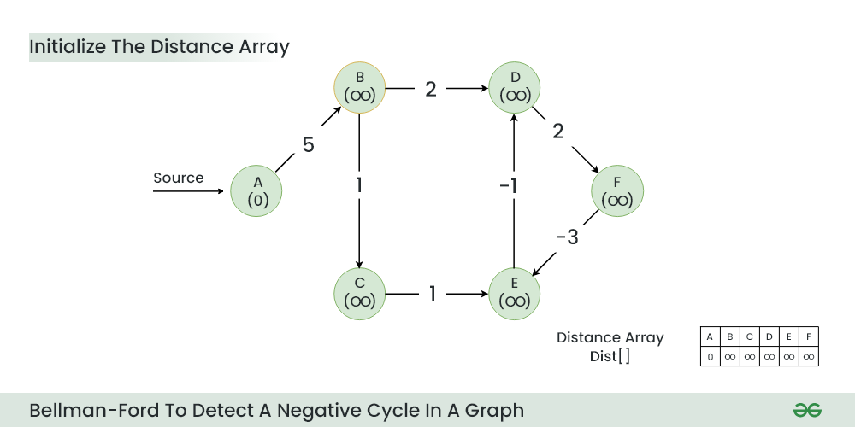
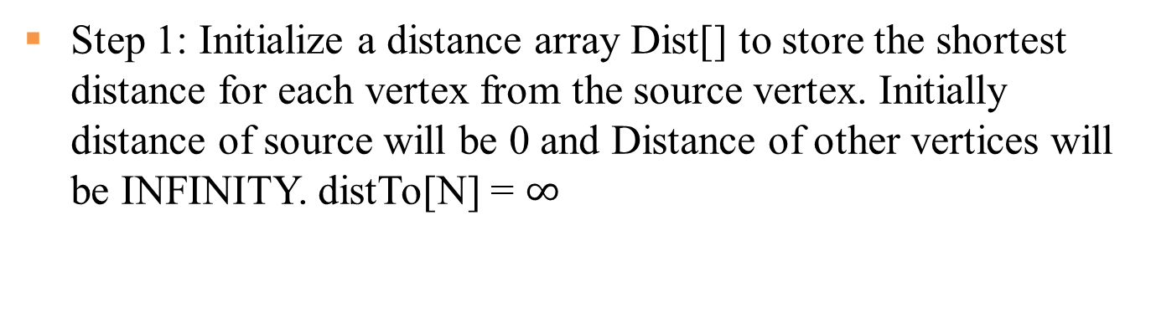
Step 1: Initialize a distance array Dist[] to store the shortest distance for each vertex from the source vertex. Initially distance of source will be 0 and Distance of other vertices will be INFINITY. distTo[N] = $∞$

Slide 46
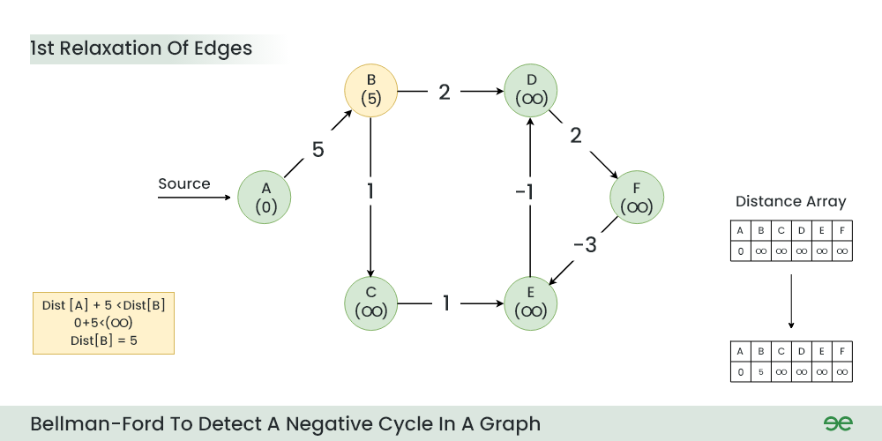
Step 2: Start relaxing the edges, during 1st relaxation:
OLD distTo[B] = ∞ > distTo[A] + e[A][B].weight() = 0+5 = 5
NEW distTo[B] = distTo[A] + e[A][B].weight() = 5

Slide 47
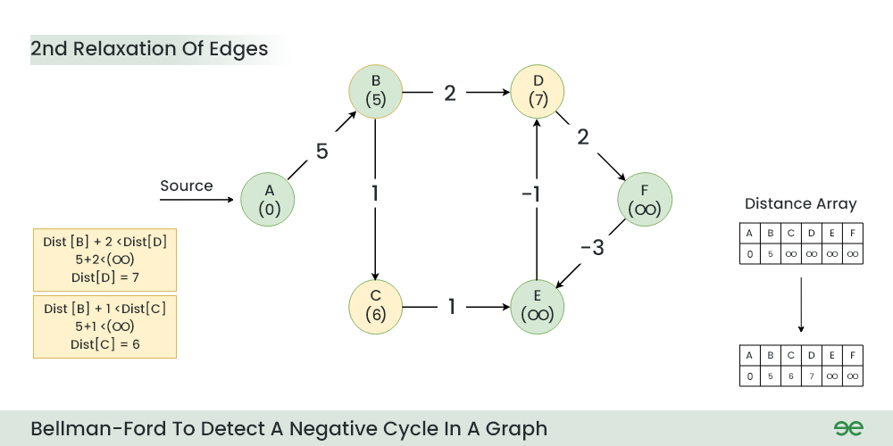
Step 3: During 2nd relaxation:
OLD distTo[D] = ∞ > distTo[B] + e[B][D].weight() = 5+2 = 7
NEW distTo[D] ← distTo[B] + e[B][D].weight() = 7
OLD distTo[C] = ∞ > distTo[B] + e[B][C].weight() = 5+1 = 6
NEW distTo[C] ← distTo[B] + e[B][C].weight() = 6

Slide 48
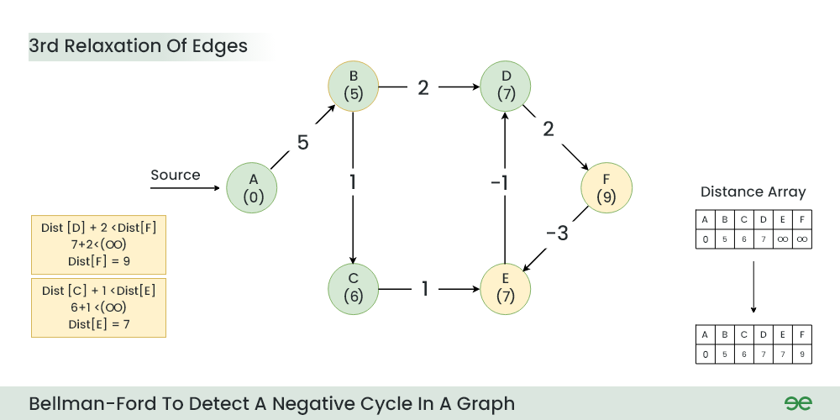
Step 4: During 3rd relaxation:
OLD distTo[F] = ∞ > distTo[D] + e[D][F].weight() = 7+2 = 9
NEW distTo[F] ← distTo[D] + e[D][F].weight() = 9
OLD distTo[E] = ∞ > distTo[C] + e[C][E].weight() = 6+1 = 7
NEW distTo[E] ← distTo[C] + e[C][E].weight() = 7
Notes:
Current Distance of F > (Distance of D ) + (Weight of D to F) i.e. Infinity > 7 + 2
Dist[F] = 9
Current Distance of E > (Distance of C ) + (Weight of C to E) i.e. Infinity > 6 + 1
Dist[E] = 7

Slide 49
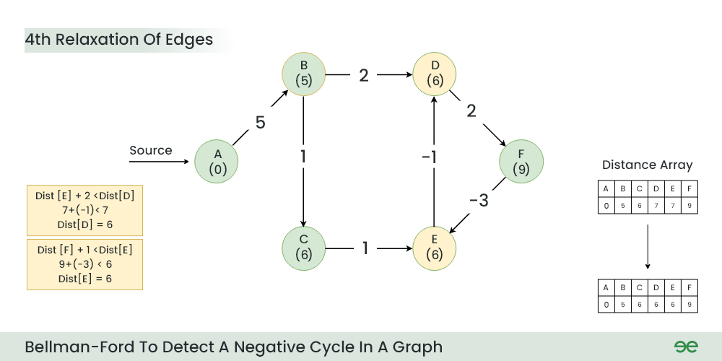
Step 5: During 4th relaxation:
OLD distTo[D] = 7 > distTo[E] + e[E][D].weight() = 7-1 = 6
NEW distTo[D] ← distTo[E] + e[E][D].weight() = 6
OLD distTo[E] = 7 > distTo[F] + e[F][E].weight() = 9-3 = 6
NEW distTo[E] ← distTo[F] + e[F][E].weight() = 6
Notes:
Current Distance of D > (Distance of E) + (Weight of E to D) i.e. 7 > 7 + (-1)
Dist[D] = 6
Current Distance of E > (Distance of F ) + (Weight of F to E) i.e. 7 > 9 + (-3)
Dist[E] = 6

Slide 50
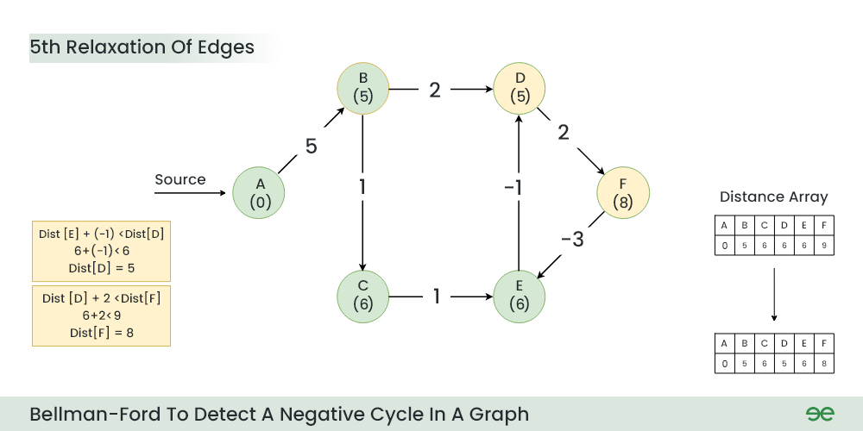
Step 6: During 5th relaxation:
OLD distTo[F] = 9 > distTo[D] + e[D][F].weight() = 6+2 = 8
NEW distTo[D] ← distTo[D] + e[D][F].weight() = 8
OLD distTo[D] = 6 > distTo[E] + e[E][D].weight() = 6-1 = 5
NEW distTo[E] ← distTo[E] + e[E][D].weight() = 5
Since the graph h 6 vertices, So during the 5th relaxation the shortest distance for all the vertices should have been calculated.
Notes:
Current Distance of F > (Distance of D) + (Weight of D to F) i.e. 9 > 6 + 2
Dist[F] = 8
Current Distance of D > (Distance of E ) + (Weight of E to D) i.e. 6 > 6 + (-1)
Dist[D] = 5

Slide 51
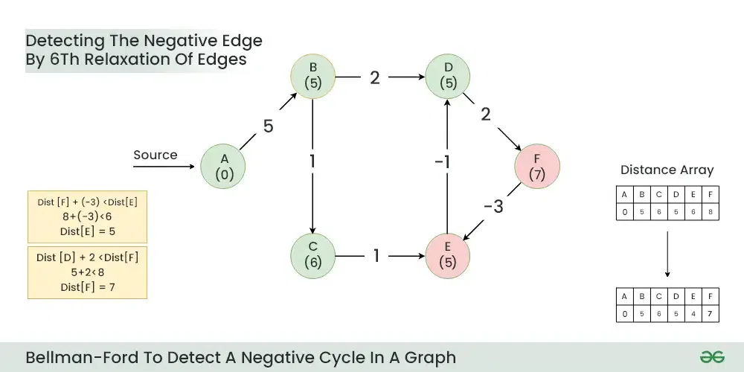
Step 7: Now the final relaxation i.e. the 6th relaxation should indicate the presence of negative cycle if there is any changes in the distance array of 5th relaxation.
During the 6th relaxation, following changes can be seen:
OLD distTo[E] = 6 > distTo[F] + e[F][E].weight() = 8-3 = 5
NEW distTo[D] ← distTo[F] + e[F][E].weight() = 5
OLD distTo[F] = 8 > distTo[D] + e[D][F].weight() = 5+2 = 7
NEW distTo[E] ← distTo[D] + e[D][F].weight() = 7
Since, we observer changes in the Distance array. Hence ,we can conclude the presence of a negative cycle in the graph (D->F->E).
Notes:
Current Distance of E > (Distance of F) + (Weight of F to E) i.e. 6 > 8 + (-3)
Dist[E]=5
Current Distance of F > (Distance of D ) + (Weight of D to F) i.e. 8 > 5 + 2
Dist[F]=7

Slide 52
Dijkstra's Algorithm vs. Bellman-Ford Algorithm
Dijkstra's Algorithm:
Uses a priority queue to select the next vertex to process.
Greedily selects the vertex with the smallest tentative distance to source node.
Works only on graphs with non-negative edge weights.
Time complexity of O(V^2) for a dense graph and O(E log V) for a sparse graph.
Bellman-Ford Algorithm:
Iteratively relaxes all edges V-1 times, where V is the number of vertices.
Does not use a priority queue.
Can handle graphs with negative edge weights, and can detect negative cycles.
Time complexity of O(VE), where V is the number of vertices and E is the number of edges in the graph.
Dijkstra's algorithm is faster and more efficient for graphs with non-negative weights, the Bellman-Ford Algorithm Example 1 is more versatile as it can handle negative weights and detect negative cycles, albeit at the cost of lower efficiency.
Notes:
Dijkstra's Algorithm:
- Finds the shortest path from a single source vertex to all other vertices in a graph with non-negative edge weights.
**Bellman-Ford Algorithm:**
- Finds the shortest path from a single source vertex to all other vertices in a graph, even with negative edge weights.
- Can detect negative cycles in the graph.
## Edge Weight Handling
**Dijkstra's Algorithm:**
- Works only on graphs with non-negative edge weights.
**Bellman-Ford Algorithm:**
- Can handle graphs with negative edge weights.
- Can detect negative cycles.
## Performance
Dijkstra's Algorithm:
- More efficient for graphs with non-negative weights.
- Time complexity: O(V log V + E) with a binary heap implementation, where V is the number of vertices and E is the number of edges.
**Bellman-Ford Algorithm:**
- Generally slower than Dijkstra's.
- Time complexity: O(VE), where V is the number of vertices and E is the number of edges.
## Implementation

Slide 53
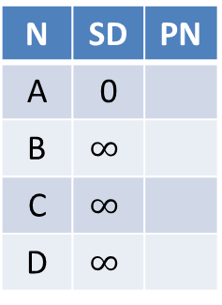
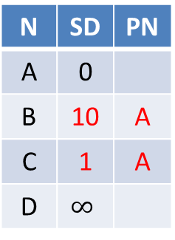
Dijkstra’s Algorithm does not work for Negative Edge Weights
Dijkstra’s Algorithm is greedy and optimal: any node that has been visited should have its shortest distance to the source. After visiting A, C, D, we have got D’s shortest distance to A is 2, but after visiting D, D’s distance to A is updated to -10, which violates the greedy optimal assumption of Dijkstra’s Algorithm.
N | SD | PN
A | 0
B | $$∞$$
C | $$∞$$
D | $$∞$$
N | SD | PN
A | 0
B | 10 | A
C | 1 | A
D | $$∞$$
N | SD | PN
A | 0
B | 10 | A
C | 1 | A
D | 2 | C
N | SD | PN
A | 0
B | 10 | A
C | 1 | A
D | 2 | C
Visit A
Visit C
Visit D
Visit B
B
N | SD | PN
A | 0
B | 10 | A
C | 1 | A
D | -10 | B
10
-20
A
D
Incorrect
1
1
C
Notes:
Run Dijkstra’s algorithm on this graph, starting from node A. Run it anyway.
• A → B: 10
• A → C: 1
• B → D: -20
• C → D: 1
Since Dijkstra’s Algorithm is a greedy algorithm, it visits A, C, D, then finishes. I

Slide 54

Bellman Ford Algorithm works for Negative Edge Weights
We run for V-1=3 iterations, then run one more iteration with no change. Hence we conclude that The Bellman-Ford algorithm successfully calculated the shortest paths from node A to all other nodes. The shortest path from node A to node D goes through node B with a total cost of -10. There are no negative weight cycles.
N | SD | PN
A | 0
B | $$∞$$
C | $$∞$$
D | $$∞$$
N | SD | PN
A | 0
B | 10 | A
C | 1 | A
D | -10 | B
N | SD | PN
A | 0
B | 10 | A
C | 1 | A
D | -10 | B
N | SD | PN
A | 0
B | 10 | A
C | 1 | A
D | -10 | B
Iter 1
Iter 2
Iter 3
No change
No change
Iter 4
No change
B
N | SD | PN
A | 0
B | 10 | A
C | 1 | A
D | -10 | B
10
-20
A
D
1
1
C

Slide 55
Quiz
Which of the following algorithm can be used to efficiently calculate single source shortest paths in a Directed Acyclic Graph?
Dijkstra
Bellman-Ford
Topological Sort
Strongly Connected Component
ANS: Topological Sort
Using Topological Sort, we can find single source shortest paths in O(V+E) time which is the most efficient algorithm

Slide 56
Quiz
Given a graph where all edges have positive weights, the shortest paths produced by Dijsktra and Bellman Ford algorithm may be different but path weight would always be same.
ANS: True
Dijkstra and Bellman-Ford both work fine for a graph with all positive weights, but they are different algorithms and may pick different edges for shortest paths.

Slide 57
Quiz
Match the following
Group A
a) Dijkstra's single shortest path algo
b) Bellmen Ford's single shortest path algo
c) Floyd Warshall's all pair shortest path algo
Group B
p) Dynamic Programming
q) Backtracking
r) Greedy Algorithm
Dijkstra is a greedy algorithm where we pick the minimum distant vertex from not yet finalized vertices. Bellman Ford and Floyd Warshall both are Dynamic Programming algorithms where we build the shortest paths in bottom up manner.

Slide 58
Quiz
Let G be a directed graph whose vertex set is the set of numbers from 1 to 100. There is an edge from a vertex i to a vertex j if either j = i + 1 or j = 3i. The minimum number of edges in a path in G from vertex 1 to vertex 100 is
A. 4 B. 7 C. 23 D. 99
ANS: 7
The task is to find minimum number of edges in a path in G from vertex 1 to vertex 100 such that we can move to either i+1 or 3i from a vertex i.
Since the task is to minimize number of edges, we would prefer to follow 3*i. Let us follow multiple of 3. 1 => 3 => 9 => 27 => 81, now we can't follow multiple of 3 anymore. So we will have to follow i+1. This solution gives a long path.
What if we begin from end, and we reduce by 1 if the value is not multiple of 3, else we divide by 3. 100 => 99 => 33 => 11 => 10 => 9 => 3 => 1
So we need total 7 edges.

